Slide 1

Dark Wolf Hack Our Drone
Unmanned Aerial Vehicle

Slide 2


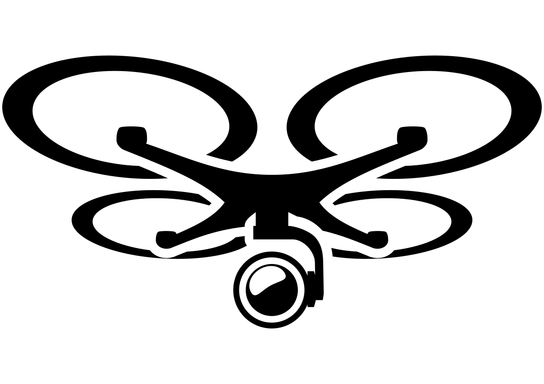




UAS OV1
Flight Control System
Sensors
Compass
Accelerometer
GPS
Payloads
Video
Other
Motors / ESC
Power Monitoring and Distribution
GPS
ADS-B
RF
Wifi
Supply Chain
RF
Wifi
Software Libraries

Slide 3
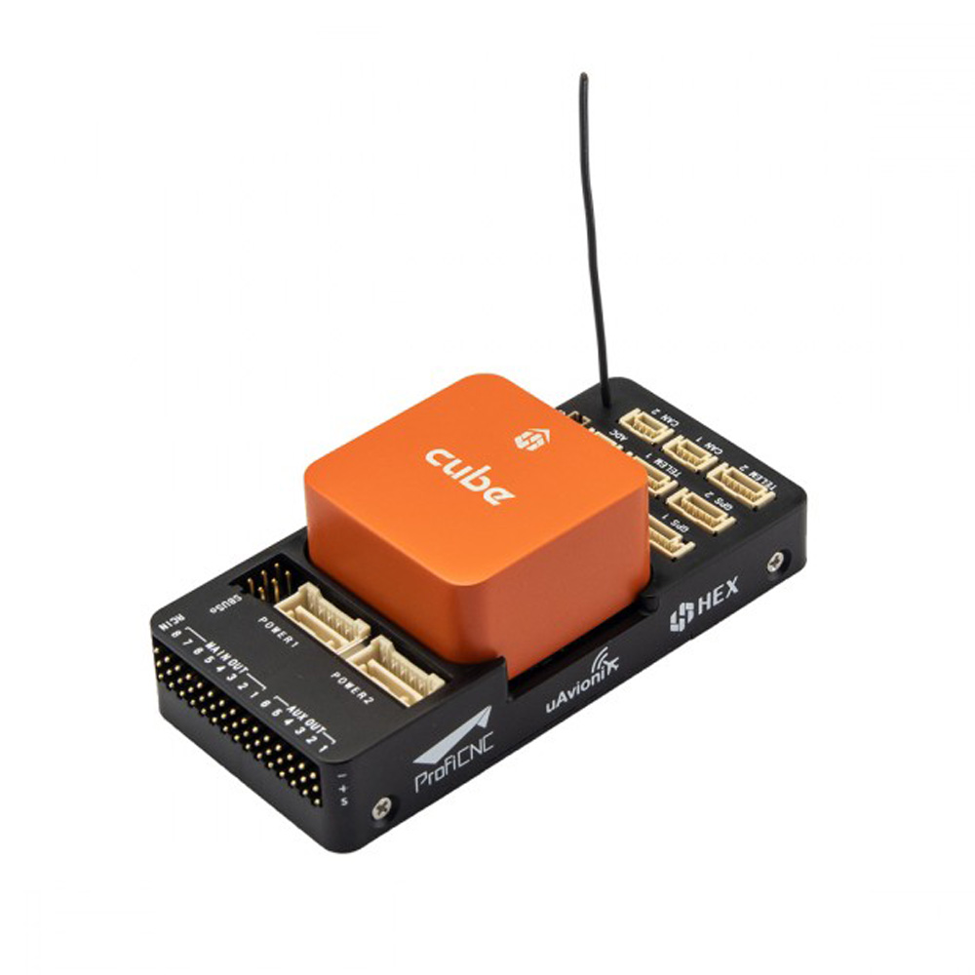
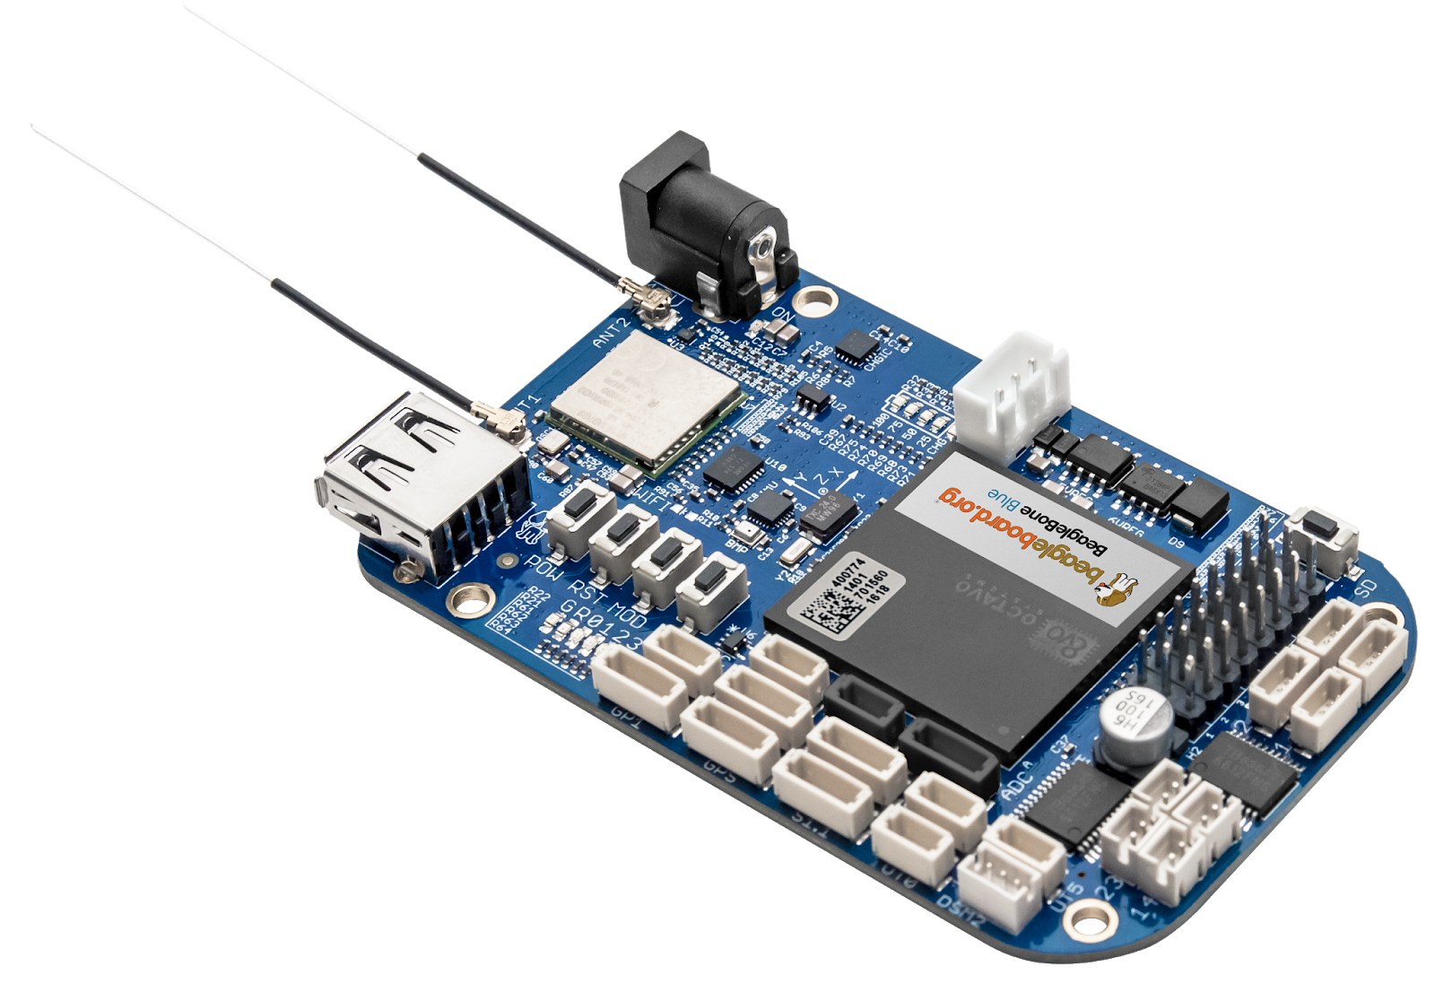
UAV: Hardware Platform
Embedded
STM32
Pixhawk
HexCube
Arduino
ESP
Single Board Computer
ARM Linux
Raspberry Pi
BeagleBone Blue
Nvidia Tegra
X86 Boards
Intel Atom

Slide 4
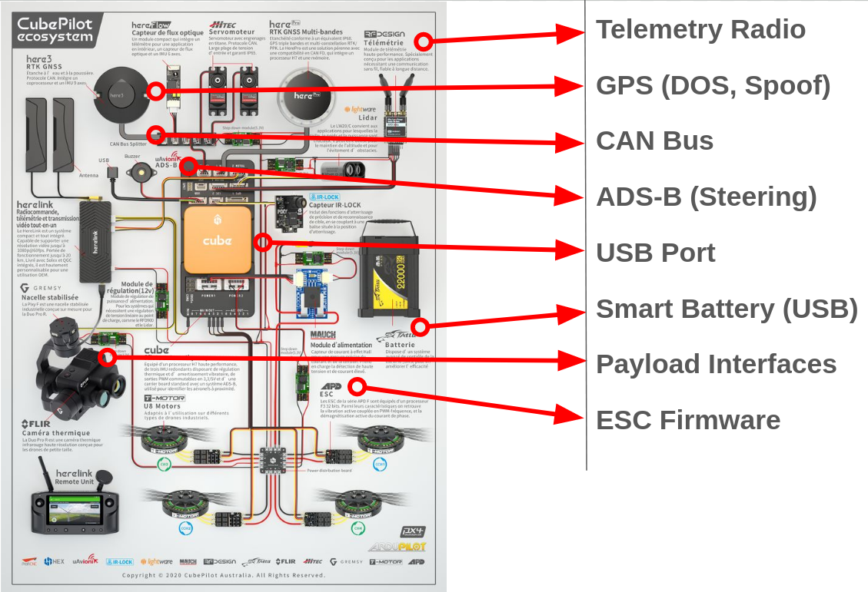
UAV (Embedded): Attack Surface

Slide 5
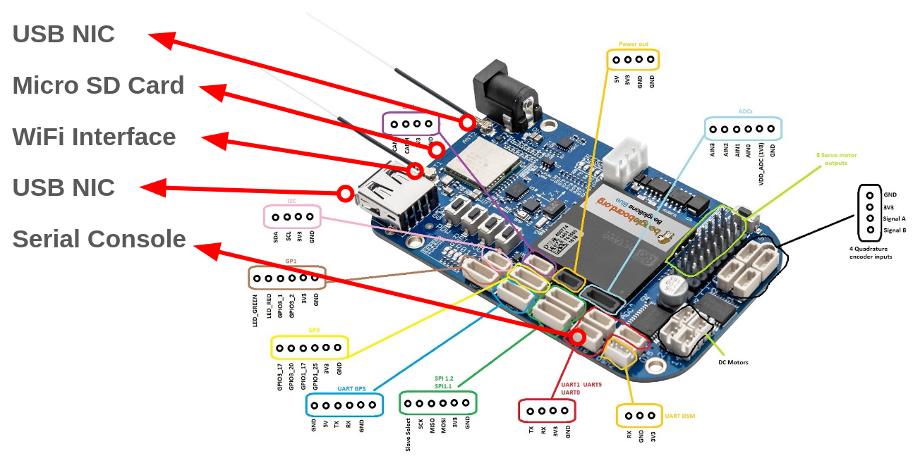
UAV (SBC): Attack Surface

Slide 6
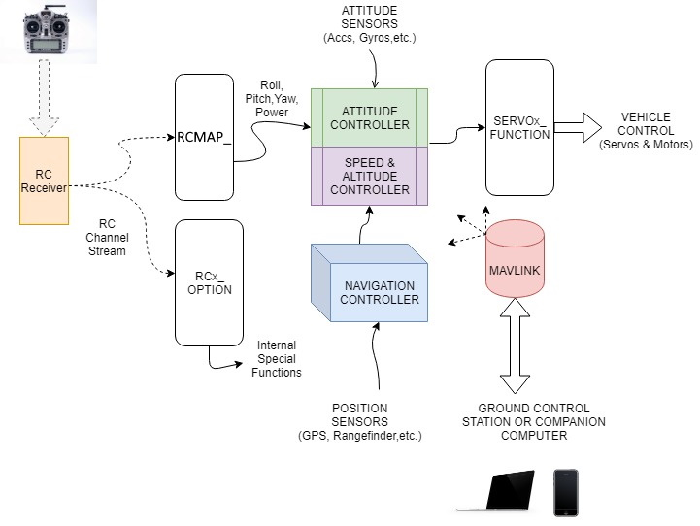
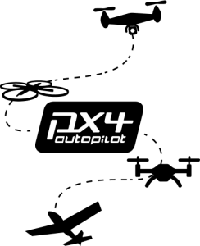

UAV: Flight Firmware
Two Open Source Flight Software
PX4
ArduPilot

Slide 7
UAV: Companion Computers
Many UAV separate the flight controller from other compute functions by using a second compute resource - a companion computer or companion board
This is almost always hosting a Linux operating system.

Slide 8
UAS Unmanned Aerial Vehicle
Lab Overview

Slide 9
Hack Our Drone: Comms Lab Task List
Network Interfaces
USB 0
WiFi
Scans
Initial Login
Login
OODA
Root and Loot
Credentials
github
Privilete Escalation
suid files

Slide 11
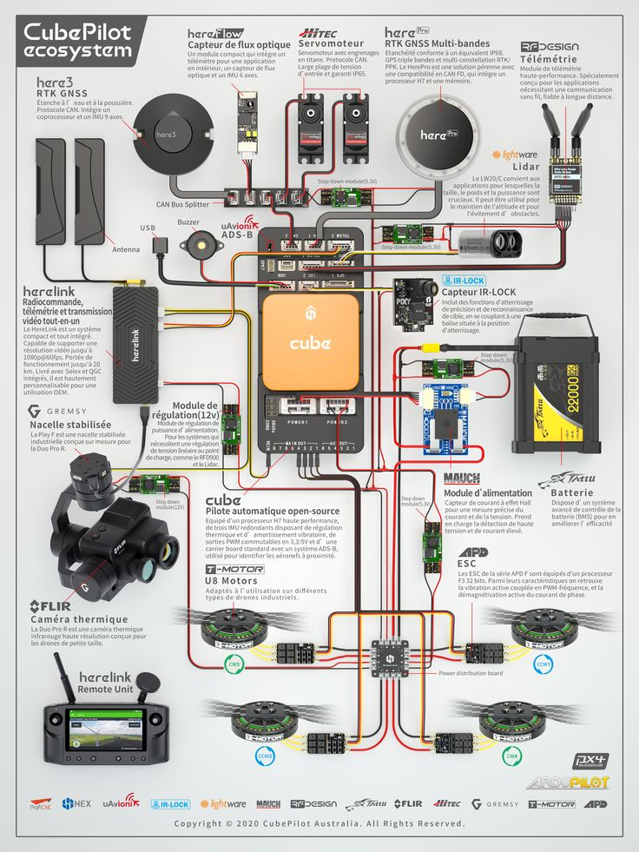
UAV: Attack Surface #1
Telemetry Radio
GPS (DOS, Spoof)
CAN Bus
ADS-B (Steering)
USB Port
Smart Battery (USB)
Payload Interfaces
ESC Firmware

Slide 12
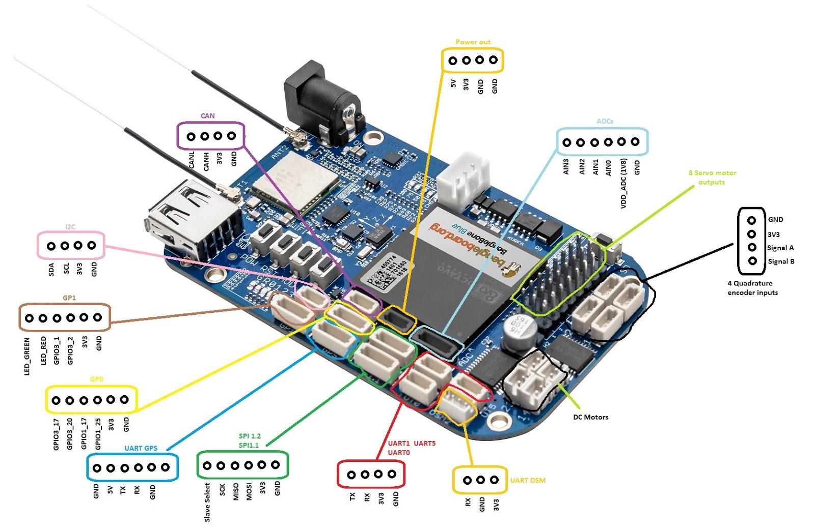
UAV: Attack Surface #2
USB NIC
Micro SD Card
WiFi Interface
USB NIC
Serial Console

